Slide 1
Conversion of CSV to Database

Slide 2
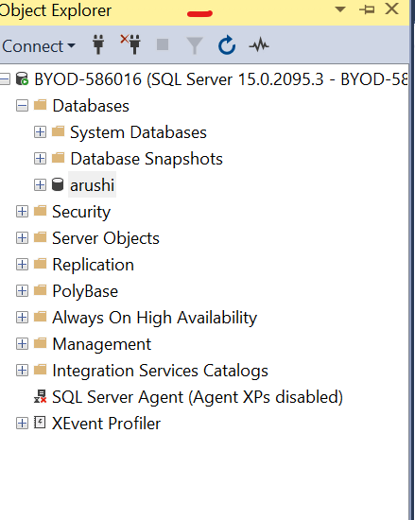
Step 1
Choose database in MsSQL Server

Slide 3
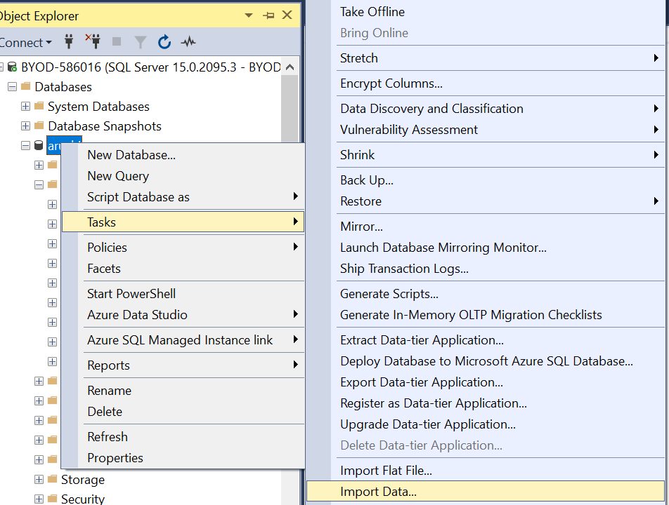
Steps 2
Click on database and choose task and select import data

Slide 4
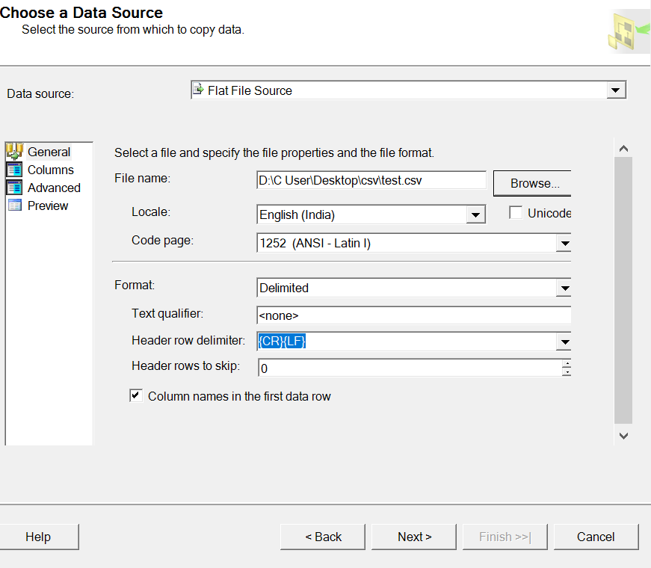
Step 3
Choose data source (Flat file source)
Browse file name (where save the CSV file)
Click on Next

Slide 5
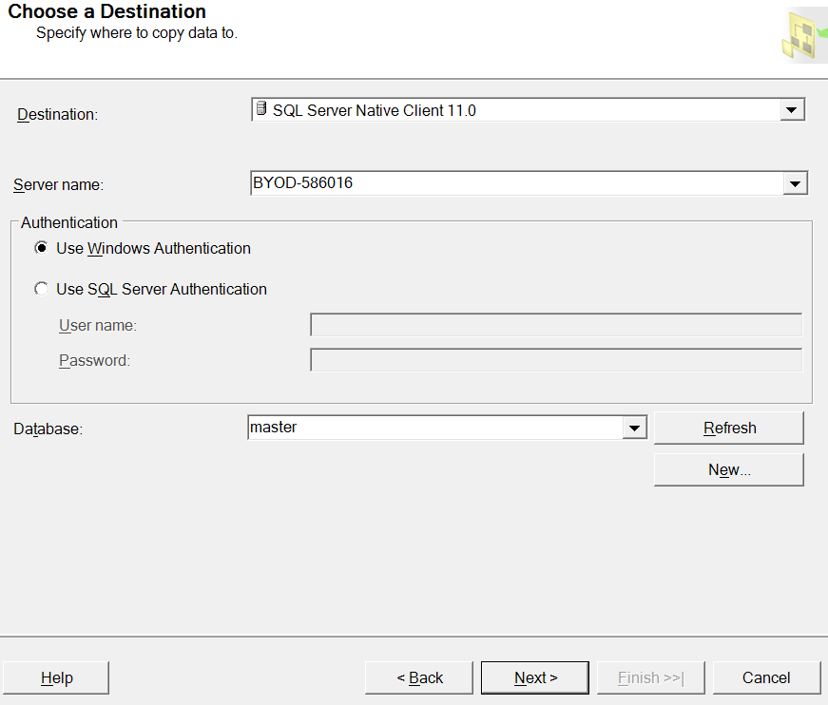
Step 4
Choose data destination (SQL server Native Client 11.0)
Server name
Choose Database
Click on Next

Slide 6
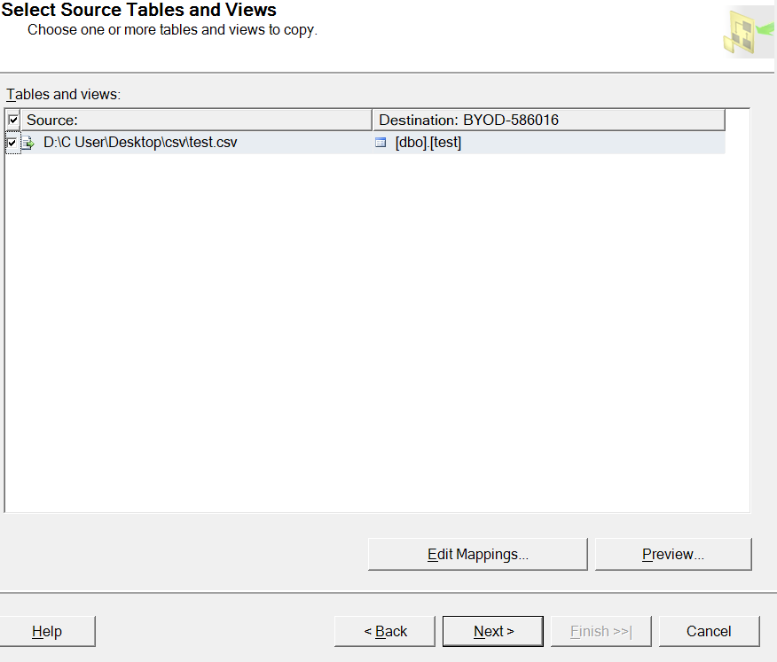
Select Source table and View
Click on Next

Slide 7
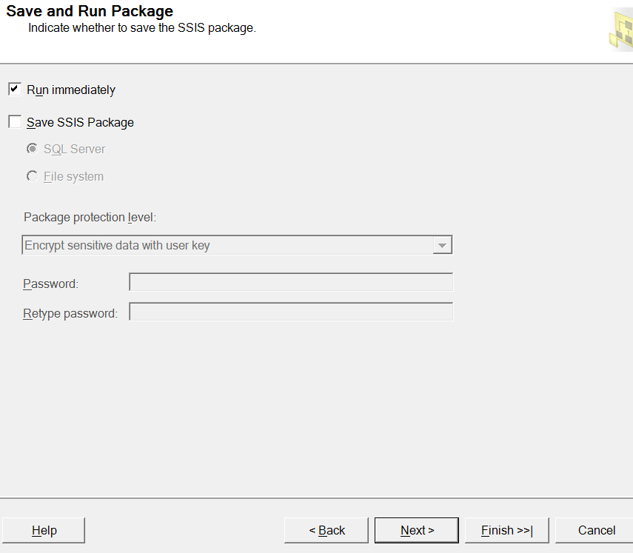
Save And Run Package
Click on Run immeditely
Click on Next

